Slide 1
Board on the Bus Listening in our Communities

Slide 2
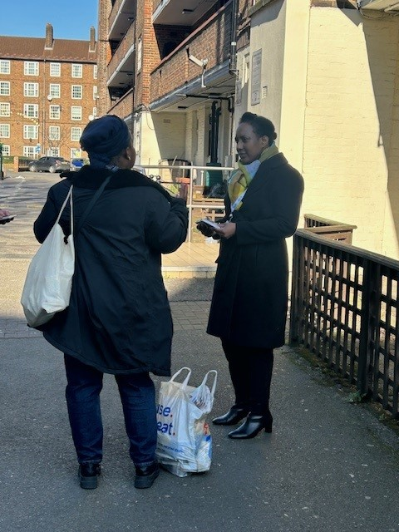
Board on the Bus: out in the community in March at Kennington Park Community Centre – 3 March 2025 Lorraine Gordon, Interim Director, Living Well Network Alliance and Alex Jackson, Programme Lead, Lambeth Together On the bus: Health Champions and a Mental Health Support Worker Age Friendly Lambeth team also present at the centre
Spoke with 19 residents
Themes from ‘what matters to you’ postcards:
Housing and environment – better access to good housing
and repairs
Better treatment for back pain, long waits for physio appointments
Better listening by GPs
More personalised care and choice for patients
More access to dentists
How to better manage stress
Availability of complementary therapies
Two residents reported no complaints!

