Slide 1
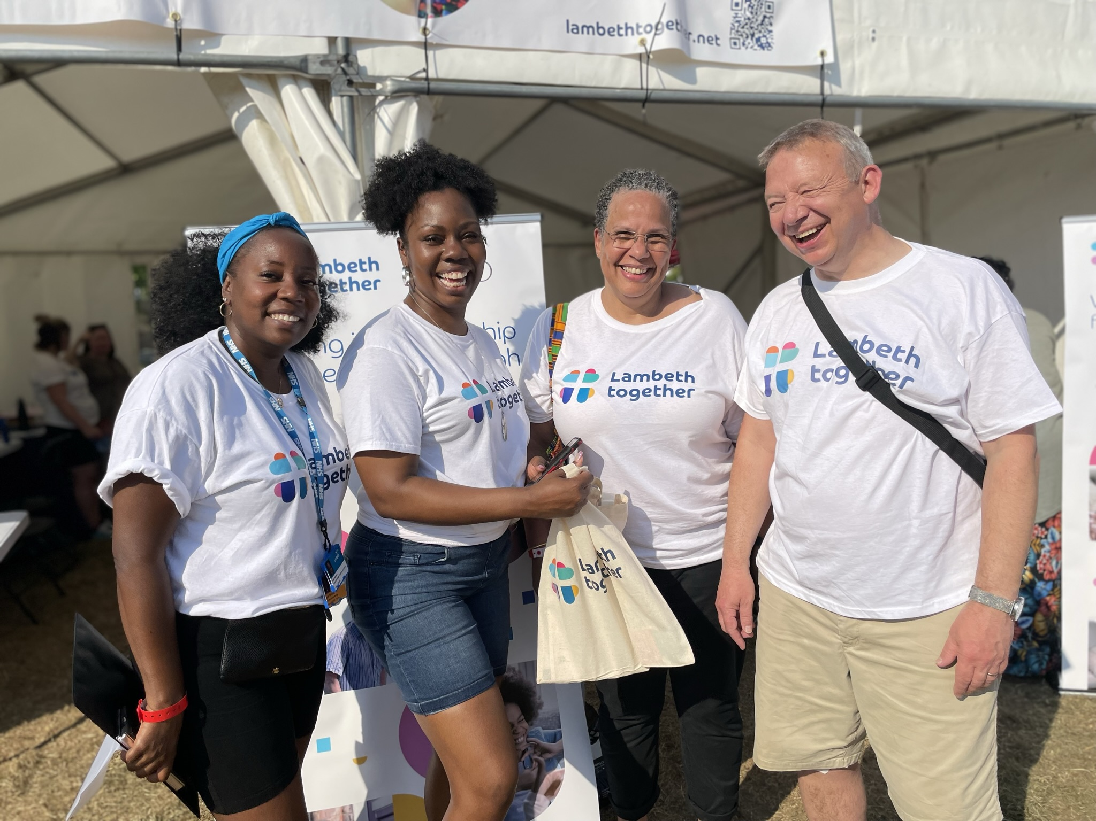
Lambeth Country Show 2023

Slide 2
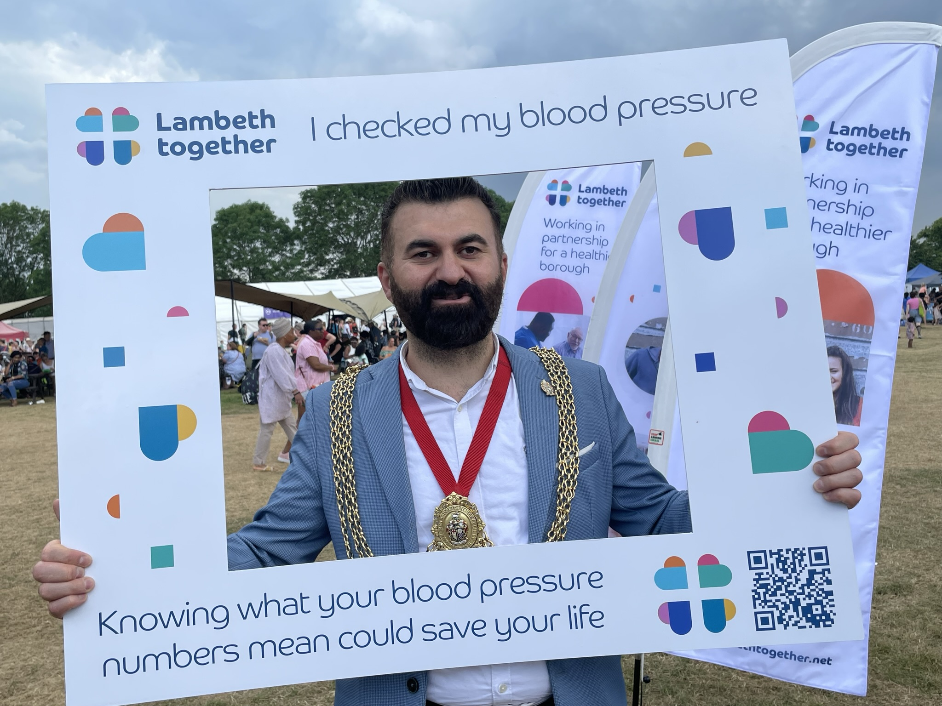
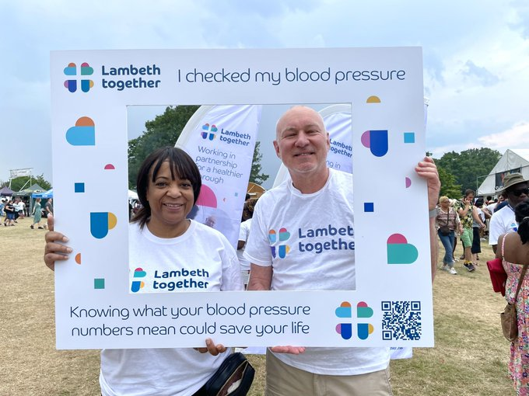
Lambeth Country Show
Partnership focus: high blood pressure
Engagement focus: what matters to you about health and care in Lambeth?
In brief: we carried out 348 blood pressure checks; 38 people were advised to follow up with their GP due to raised readings
Key health messages shared
Knowing what your blood pressure numbers mean could save your life
It’s easy to get your blood pressure checked, at your GP or community pharmacy, or you can do it at home
Where to find out more about keeping in control of your blood pressure
How we did this
We had a large marquee with health professionals from general practice, hospitals, pharmacy, and community sector partners taking blood pressure and talking to people about their results
We did advance promotion on social media and live promotion to draw people towards the Lambeth Together marquee over the weekend; people were encouraged to take and share selfies on their own social media channels to spread the messages
Listening in the community
We used the Lambeth Country Show as an opportunity for Lambeth Together’s leadership and staff to hear directly from local people outside of service settings
We used postcards with open questions designed to inform partnership priorities and gather feedback on health and care services, asking people:
What matters to you about health and care in Lambeth?
What would make the biggest difference to yours, or your family’s, health and care?
We gathered 183 postcard responses from Lambeth residents
We filmed responses to these questions from some groups we tend to see less of at our Public Forum and Board meetings, including young people and people from Black and Multi ethnic communities
We also recruited Lambeth residents to take part in the South East London Integrated Care System People’s Panel

Slide 3
What matters to Lambeth? Insights from Lambeth Country Show postcard data
Largest shift in ‘what would make the biggest difference’ categories is away from ‘Access’ to ‘Accessibility’; from timing towards inclusion and diversity, with digital access still being identified as challenging for some elderly or digitally excluded residents
Only a single mention of vaccinations (re home-schooled children), while Mpox concerns disappeared since 2022
Carers, the elderly and parents of young children raised most often as in need of more support
‘Affordable’ not mentioned once in 2022 but into double figures in 2023, reflecting pressures resulting from cost of living crisis
Mental health access and funding remain a focus
What we heard
183 comments received from Lambeth residents
We compared issues raised with what people said at 2022’s Lambeth Country Show when asked the same questions. There is broad consistency in the themes, with some changes in emphasis

Slide 4
What matters to Lambeth? Insights from Lambeth Country Show postcard data
Public ideas:
More, better paid nurses and doctors
Alternative medicines and services being offered
Focus on future proofing - avoid another Covid wave
School nurses sharing information with health services
Respect, and patient / service user concerns being taken seriously
Better disabled transport, impact of traffic changes on disabled drivers
More drop-in outdoor activities
Better public involvement in service design
Health coaches, more walking groups and cycle lanes
Housing to be considered a Public Health priority
Don’t allow ice-cream trucks outside schools (except maybe Fridays)
Common themes
One of the most common words in 2022 responses was ‘green’, with emphasis on Brockwell Park itself, and public reliance on local urban green spaces.
In 2023, in the midst of the Cost of Living crisis, the word ‘green’ was a lot less common than the word ‘free’. There was a notable rise in sentiment that there had been a reduction in free public services when there should be an increased amount of them, creating a perceived need to use private rather than NHS services, particularly for dentistry and mental health. The desire for the NHS to be preserved and privatisation to be prevented was a recurrent theme.
There were more responses about quality of life, working and housing conditions, as well as commentary on wider problems such as crime, policing and governance. There were repeated concerns expressed about keeping streets safe and keeping young people away from crime. Overall, there seemed to be less stress on the local council’s role in terms of social issues. ‘The Council’ and ‘Lambeth’ were mentioned very little outside the context of specific services this year, whereas there were multiple calls for change in ‘The Government’.
A major theme in relation to improving accessibility was the need for collaboration between different services to help reduce travel and time, but also for greater service co-ordination through a single point of contact.

